Slide 1
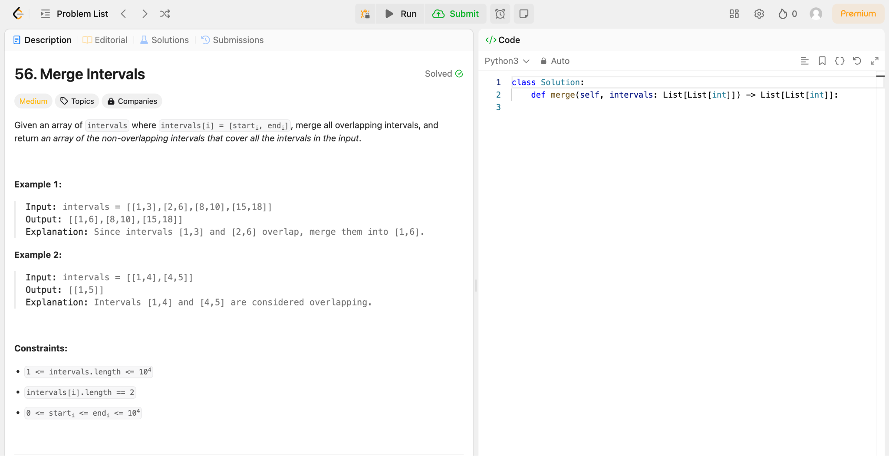

Slide 2
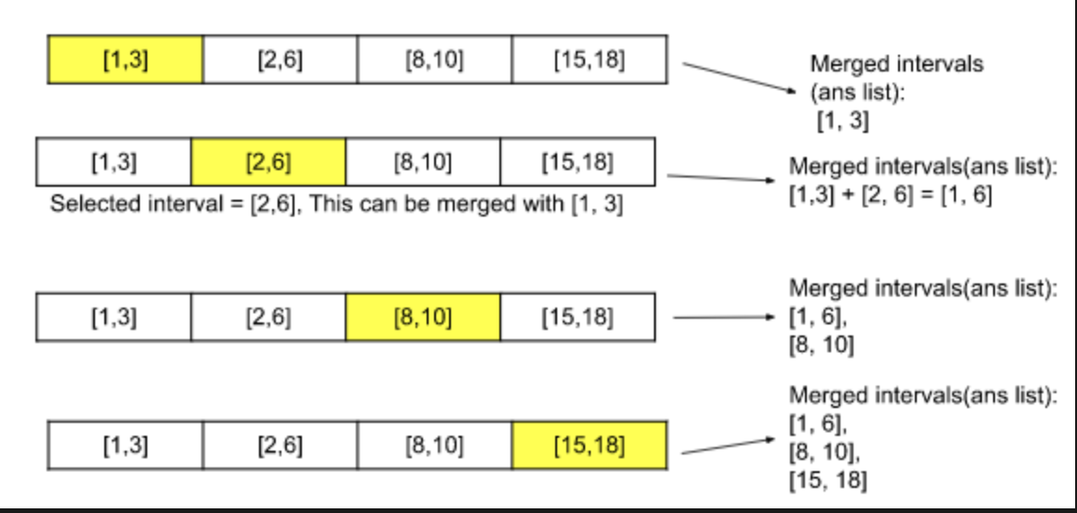

Slide 3
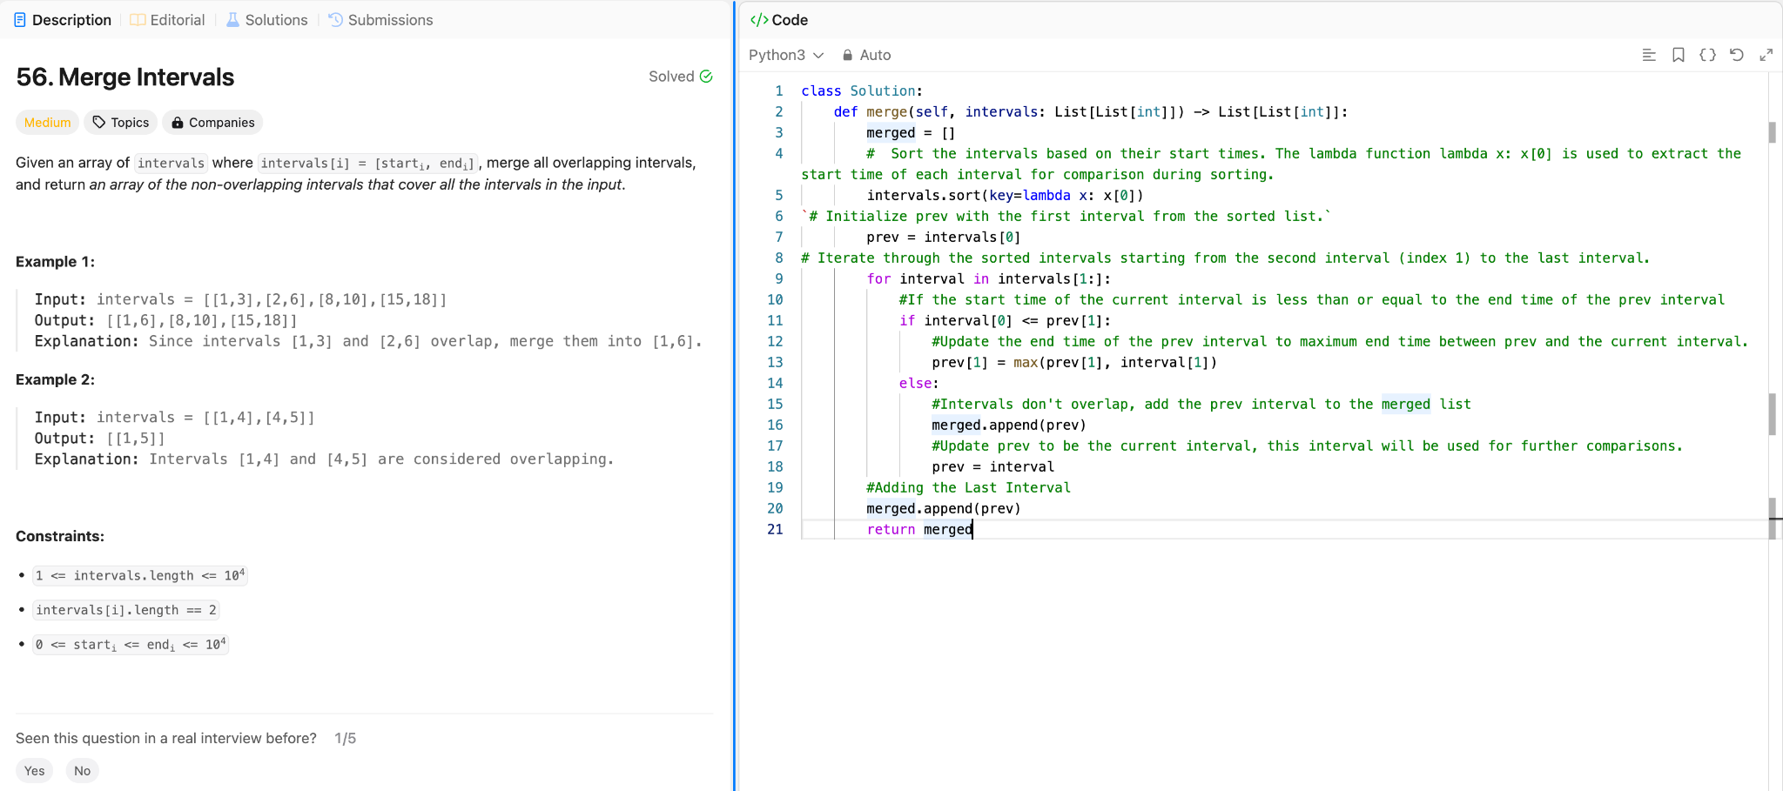

Slide 4
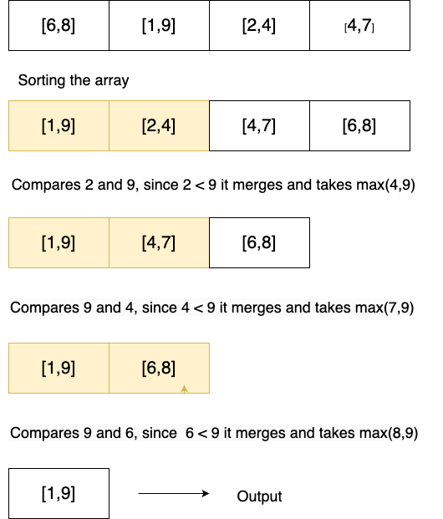

Slide 5
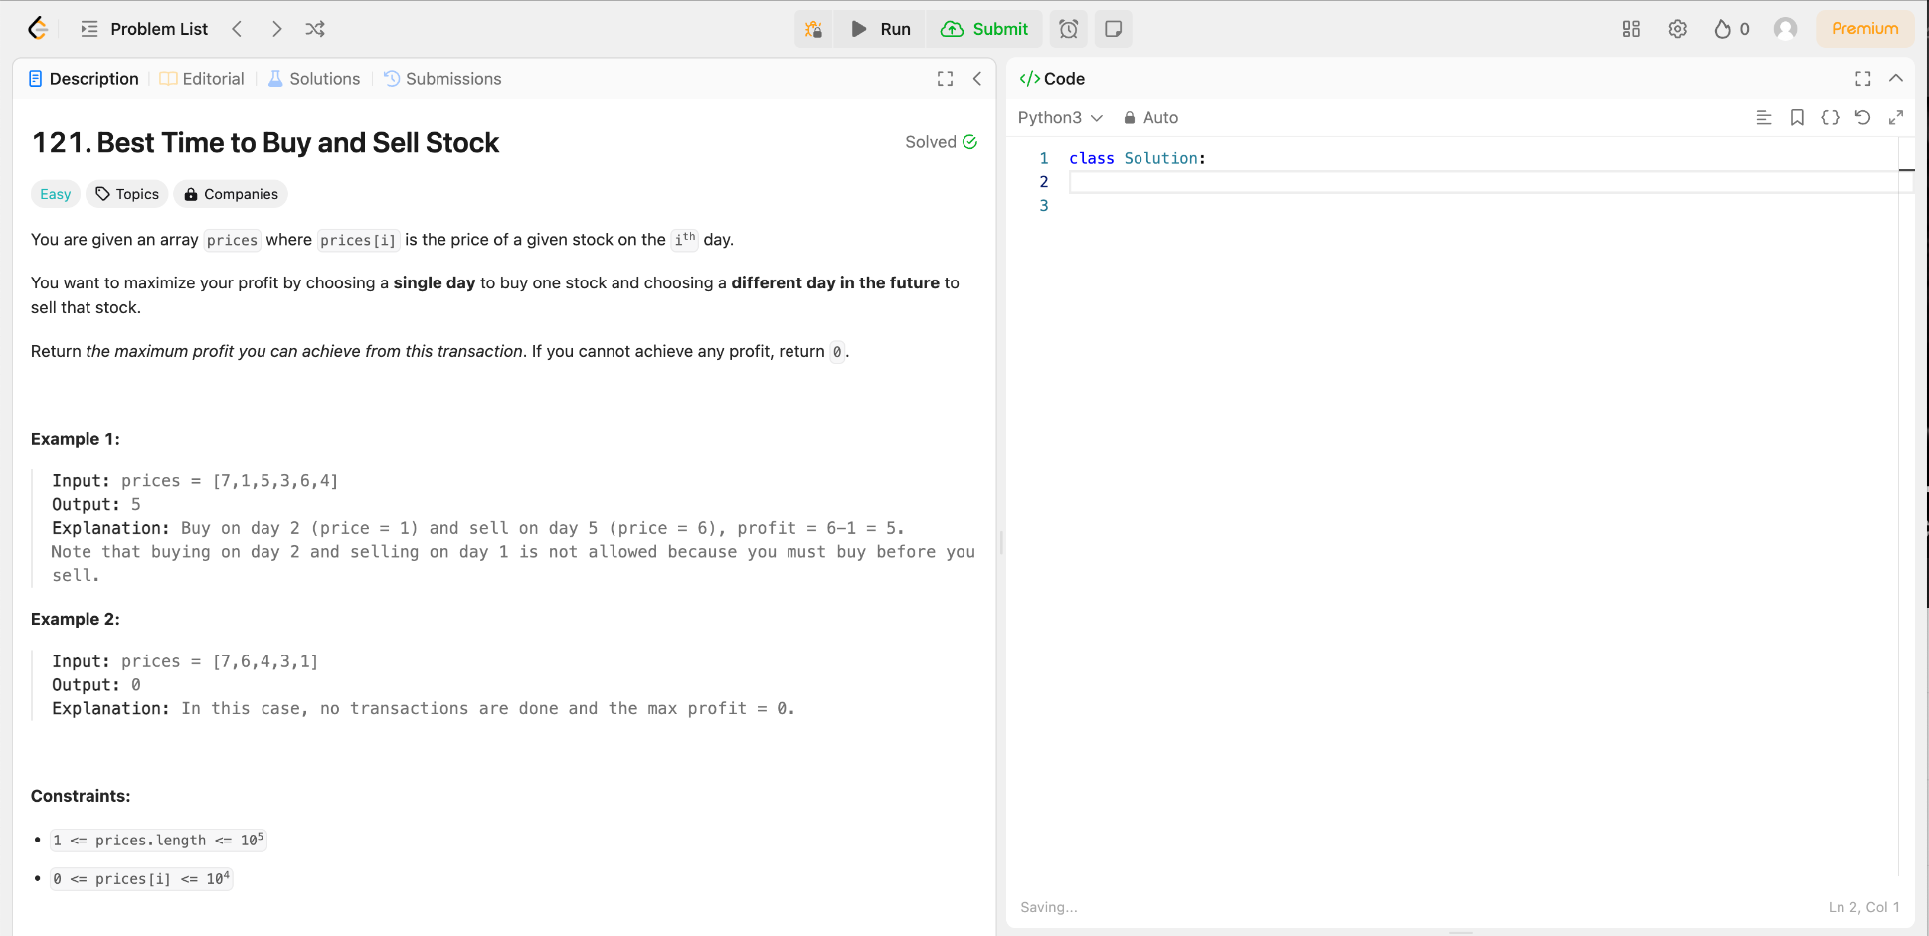

Slide 6
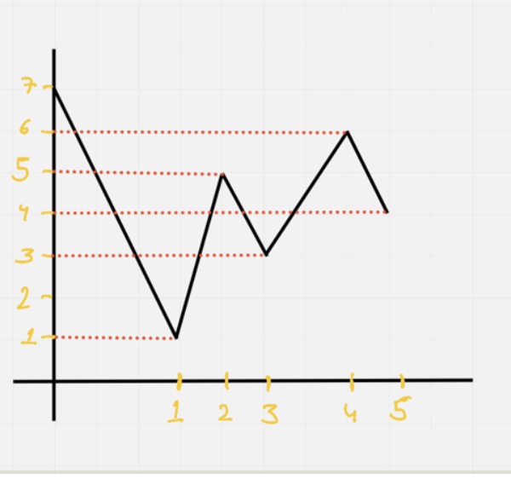
Left = 0
Right = 1
Buy | Sell | Profit
7 | 1 | -6
1 | 5 | 4
1 | 3 | 2
1 | 6 | 5

Slide 7
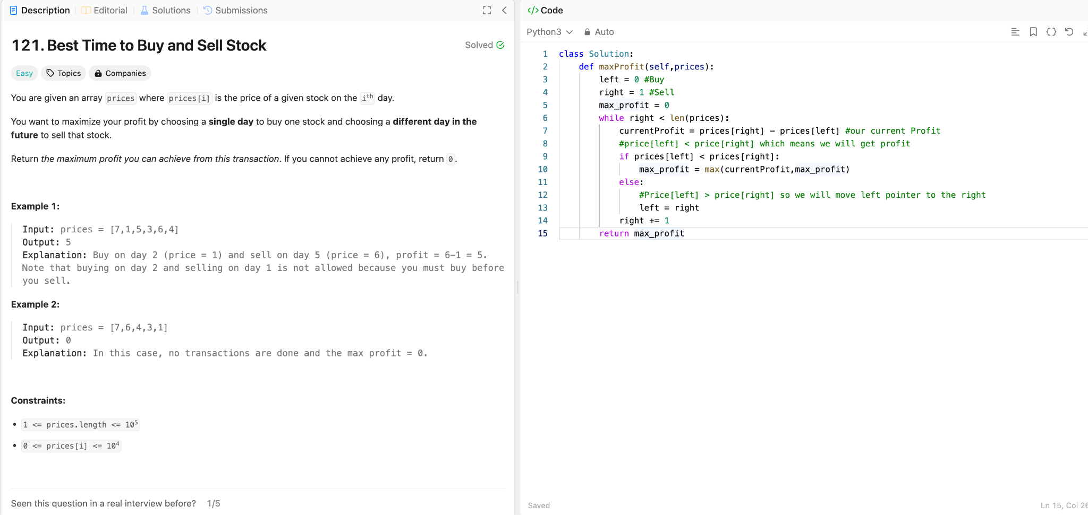

Slide 8
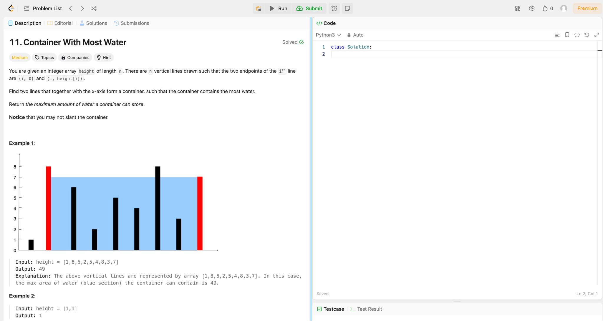

Slide 9






5.
2.
6.
3.
4.

Slide 10
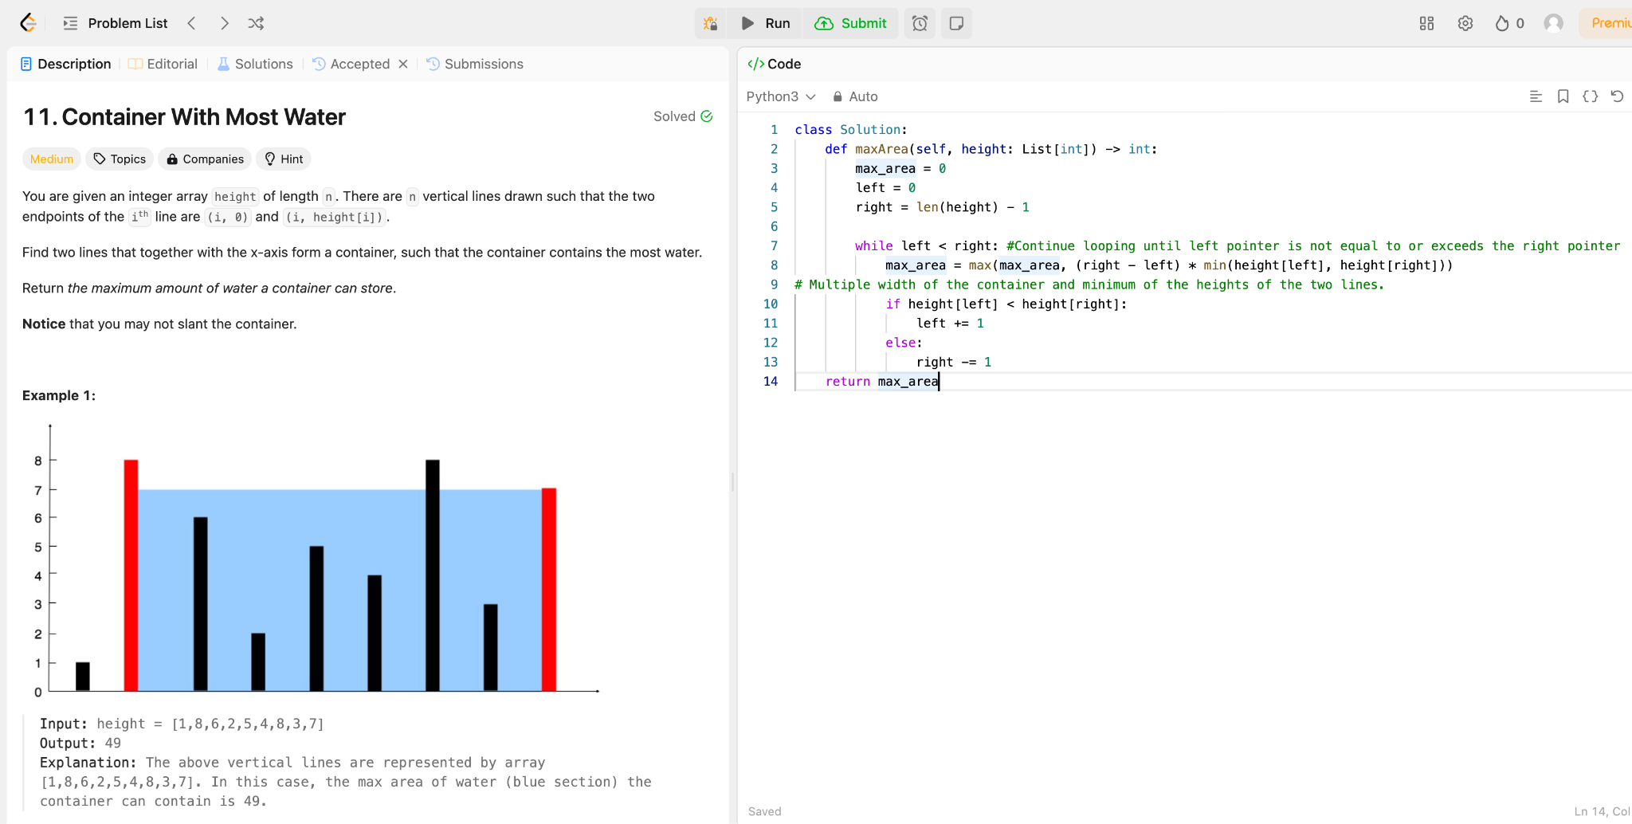

Slide 11
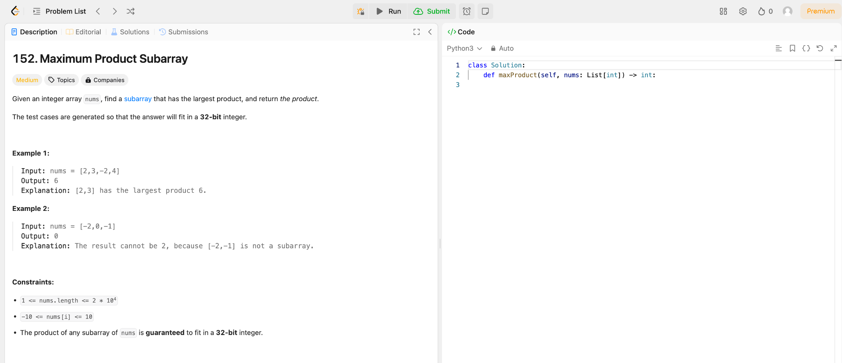

Slide 12
